Slide 1

Cloud Storage

Slide 2
Cloud Storage
Cloud storage is a service model in which data is transmitted and stored on remote storage systems, where it is maintained, managed, backed up and made available to users over a network -- typically, the internet.
Users generally pay for their cloud data storage on a per-consumption, monthly rate.

Slide 3
Classification
Cloud Storage can be classified into two categories
Ephemeral storage
Persistent storage

Slide 4
EPHEMERAL VS PERSISTENCE STORAGE
The disks associated with VMs are ephemeral, meaning that from the user's point of view they disappear when a virtual machine is terminated
Persistent storage means that the storage resource outlives any other resource and is always available, regardless of the state of a running instance , but you need to specify it during Instance creation.

Slide 5
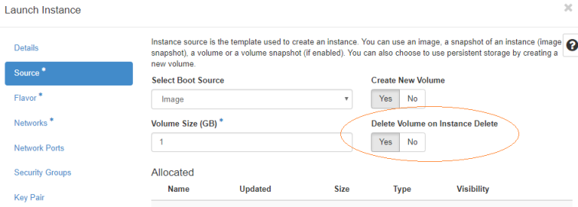

Slide 6
Persistent storage
File Storage
Block Storage
Object Storage

Slide 7
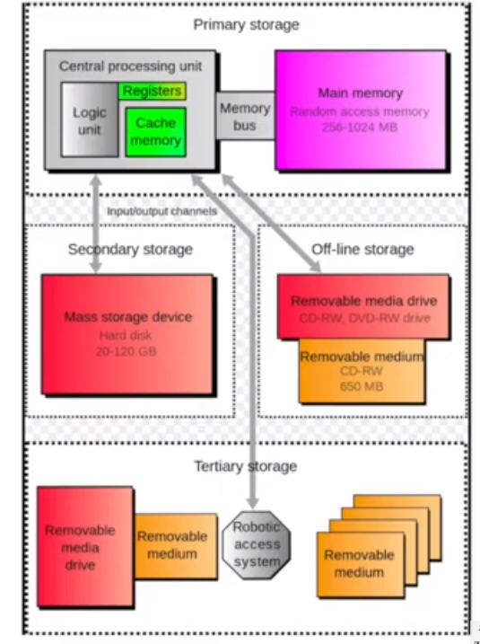
Computer Storage Types

Slide 8
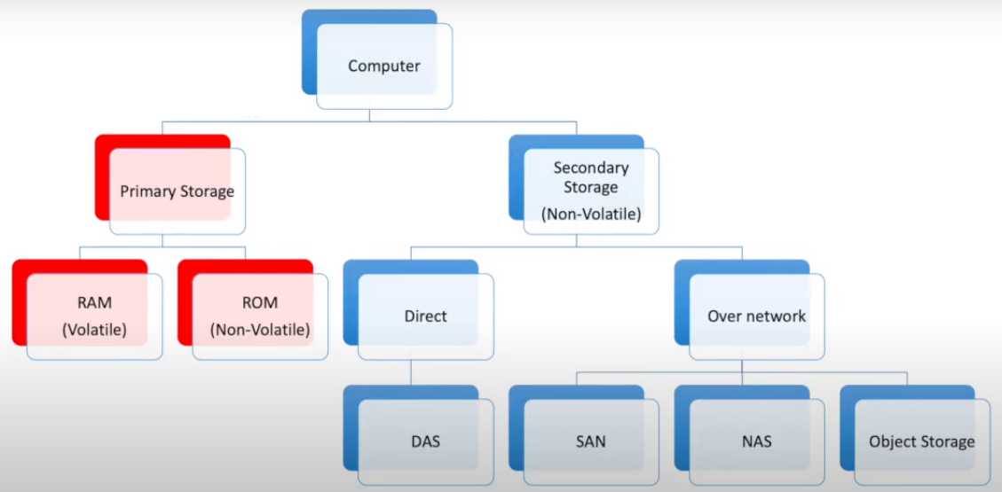

Slide 9
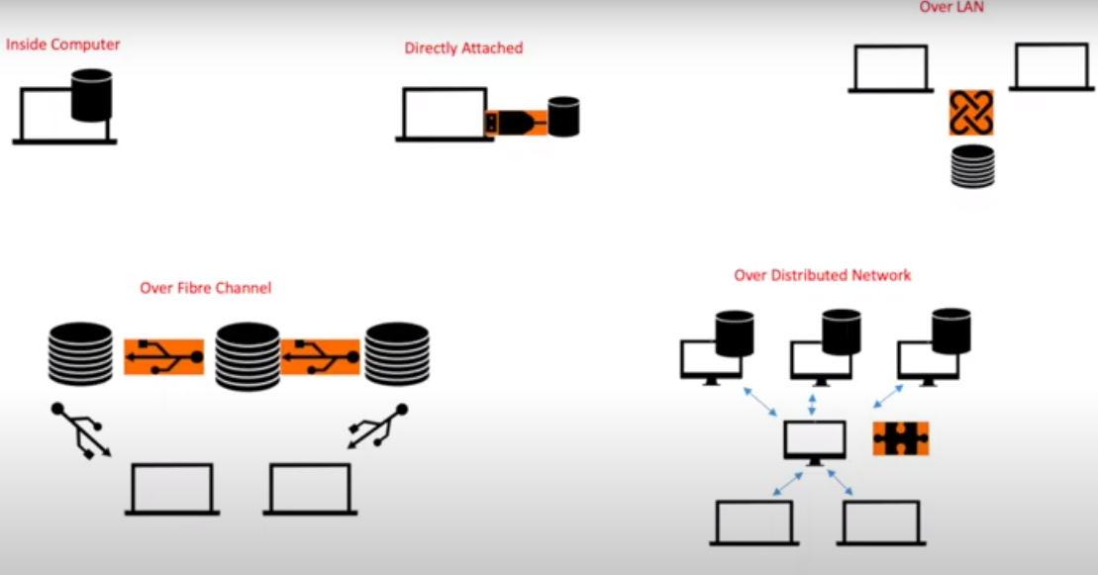

Slide 10
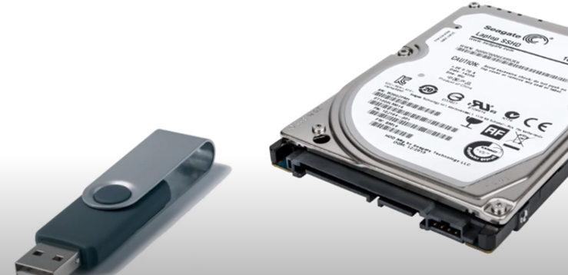
Directly Attached Storage
Cheap , Easy to use
Not Shareable

Slide 11
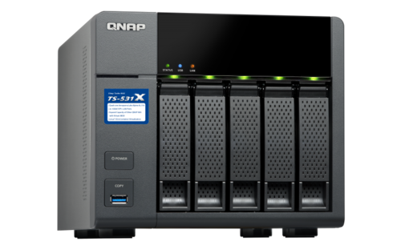
Network Attached Storage Also called File Based Storage
Connected to Network
RAID Configuration
Centralized Control
Performance affected by Network Traffic

Slide 12
(NAS) devices can utilize traditional hard disk drives (HDDs) as a storage medium.
They typically offer several drive bays, allowing users to install HDDs or solid-state drives (SSDs) for data storage
When setting up a NAS, you can choose to populate it with traditional HDDs, SSDs, or a combination of both, depending on your specific requirements for storage capacity, performance, and budget
RAID (Redundant Array of Independent Disks) is a technology commonly used in network-attached storage (NAS) systems to enhance data storage performance, availability, and reliability. It involves combining multiple physical drives into an array to create a logical volume with improved performance and data redundancy.

Slide 13
RAID 0 (Striping): Data is distributed across multiple drives in the array, resulting in increased performance as data can be read from or written to multiple drives simultaneously. However, RAID 0 does not provide data redundancy, so if one drive fails, all data in the array can be lost.
RAID 1 (Mirroring): Data is duplicated on two drives, providing redundancy. If one drive fails, the other drive still contains a complete copy of the data, ensuring data integrity. However, RAID 1 sacrifices storage capacity, as the total usable capacity is equal to that of a single drive.
RAID 5: Data and parity information are striped across multiple drives, providing a good balance of performance, storage capacity, and redundancy. In a RAID 5 array with n drives, the capacity of one drive is used for parity, allowing for n-1 drives' worth of usable capacity. If one drive fails, the missing data can be reconstructed using the parity information. However, if multiple drives fail before the failed drive is replaced and rebuilt, data loss can occur.
RAID 6: Similar to RAID 5, but with an additional level of redundancy. RAID 6 uses two drives for parity, allowing for the simultaneous failure of two drives without data loss. It offers higher fault tolerance than RAID 5 but requires a larger number of drives, reducing the usable capacity.

Slide 14
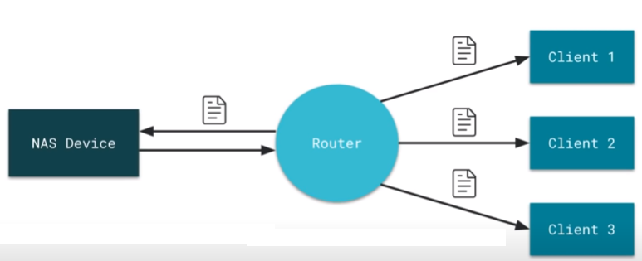
Files Transferred over Network

Slide 15
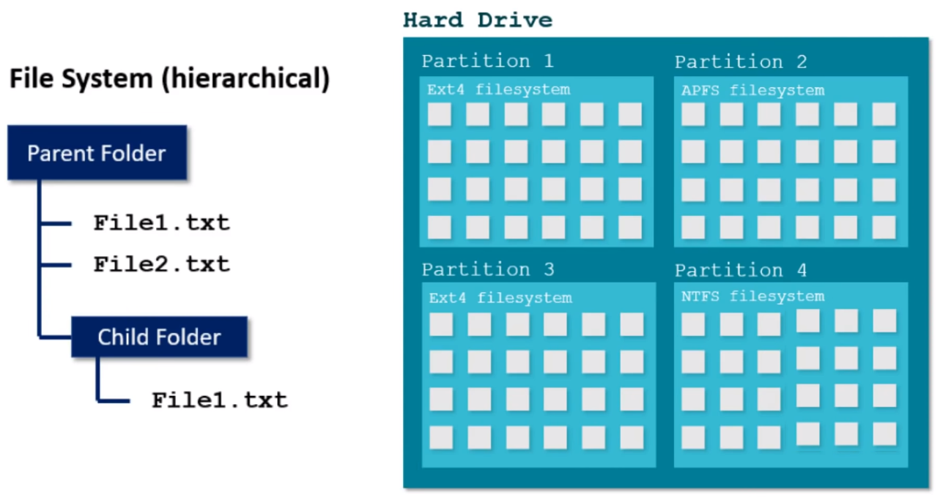
File based storage vs block storage

Slide 16
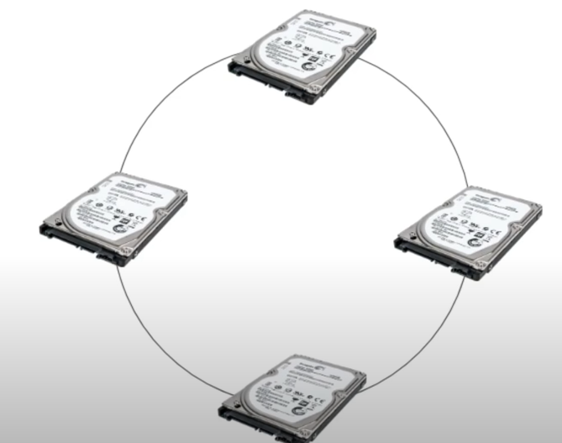
SAN Storage Area Network also called Block based Storage
NAS Devices networked on Opticalfiber cables usually

Slide 17
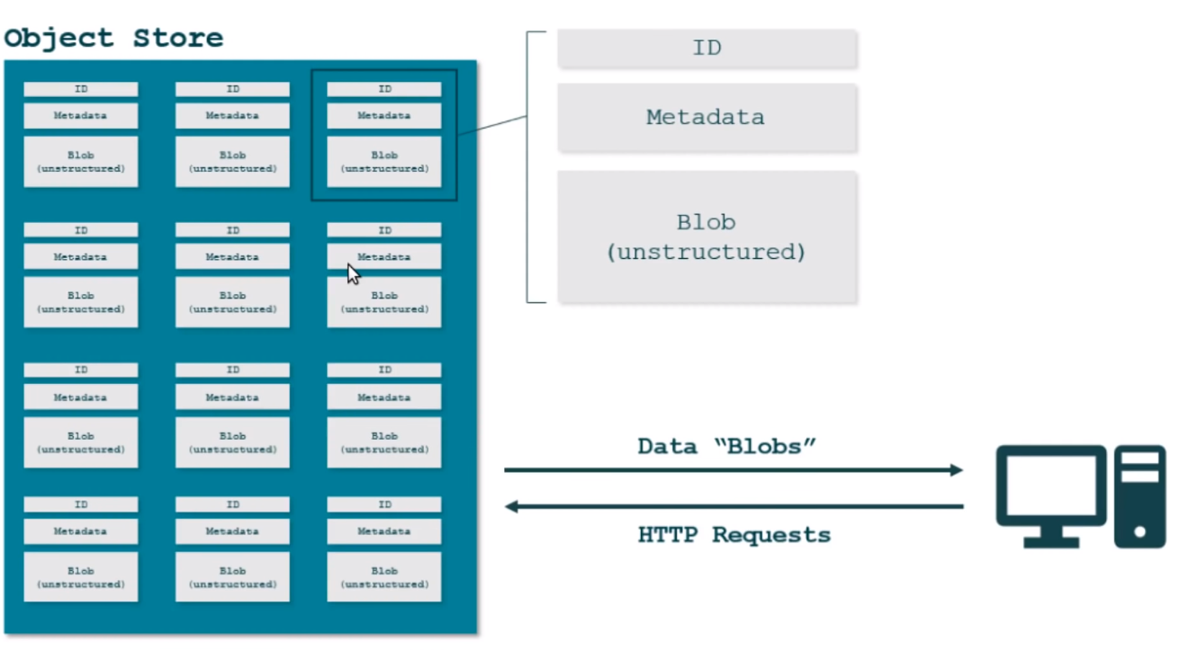
Object Storage

Slide 18
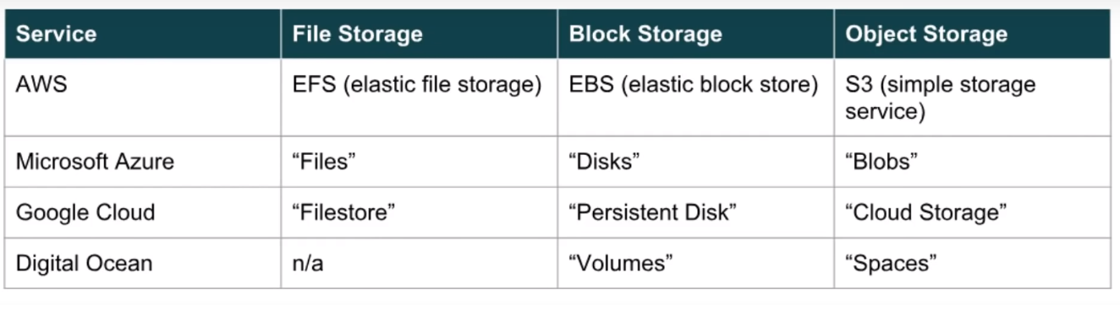
Storages Product Names by Service

Slide 19
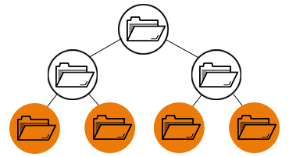
File storage
Data is stored as a single piece of information inside a folder, just like you’d organize pieces of paper inside a folder.
When you need to access that piece of data, your computer needs to know the path to find it.
Data stored in files is organized and retrieved using a limited amount of metadata that tells the computer exactly where the file itself is kept.
It’s like a library card catalog for data files.

Slide 20
Think of a closet full of file cabinets. Every document is arranged in some type of logical hierarchy—by cabinet, by drawer, by folder, then by piece of paper.
This is where the term hierarchical storage comes from, and this is file storage.
It is the oldest and most widely used data storage system for direct and network-attached storage systems, and it’s one that you’ve probably been using for decades.
Any time you access documents saved in files on your personal computer, you use file storage.
The problem is, just like with your filing cabinet, that virtual drawer can only open so far. File-based storage systems must scale out by adding more systems, rather than scale up by adding more capacity

Slide 21
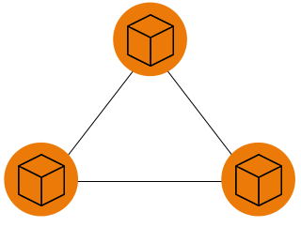
Block storage
Block storage takes a file apart into singular blocks of data and then stores these blocks as separate pieces of data.
Each block receives a unique identifier, which allows the storage system to put the blocks back together when the data they contain are needed.

Slide 22
Object Storage
Object Storage is a flat structure where there is no folder where you put your data, nor is there a specific drawer that you choose. It is more like a closet where you just drop your piece of photo, bag, luggage, shoes or whatever and it gets stored there.
But the main difference is when you drop of your object in this closet you are also adding a post it note with information about that object like the shoes, you writing down it’s color, brand, age, quality, usage, size, owner and much more, this is called metadata, and the closet will automatically split up your object in to multiple chunks and even double those chunks and put each chunk on different shelf's.

Slide 23
So when you ask for an object again you basically just insert your hand - think of the object your wanted (also called HTTP Request or Application Programming Interface, API) - and based on the metadata that’s been written down you get your object in your hand and no more hassle. And you don’t need to search, you don’t need to open any folder. Just ask for your object and you got it

Slide 24
Downside with Object Storage is that it can only be communicated over IP, the same protocol that you use for looking on websites, that means you can provide data sort of fast, but not even close as fast as Block storage can do, and it is normally very slow responding, so that means applications like a database or a virtual machine should not use Object Storage as their primary target.
Another downside is that you can’t modify a specific part of the object, instead you need to download your object, do your modification and then upload the entire object again.

